Slide 1


Multiplayer Game
Alexander Raptis

Slide 2
Database Diagram

Slide 3
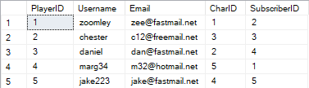
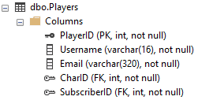
Players Table

Slide 4
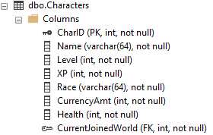
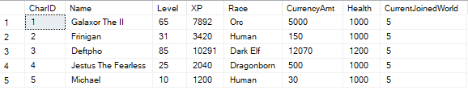
Characters Table

Slide 5
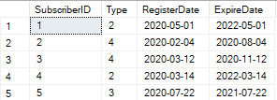
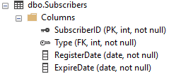
Subscribers Table

Slide 6
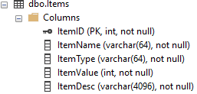
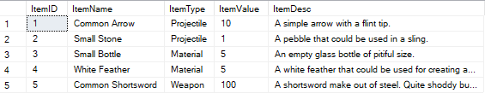
Items Table

Slide 7
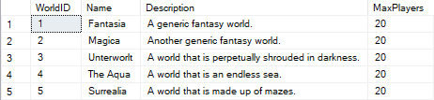
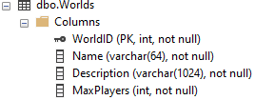
Worlds Table

Slide 8
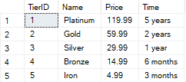
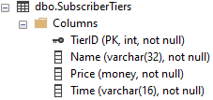
Subscriber Tiers Table

Slide 9
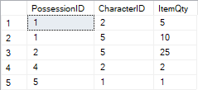
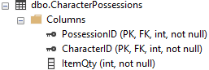
Character Possessions Table

Slide 10
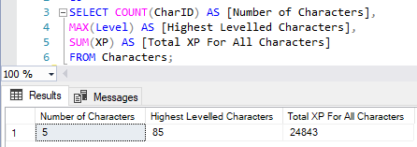
Summary Query #1
Gets total number of characters, the highest level a character has, and the total combined XP for all characters.

Slide 11
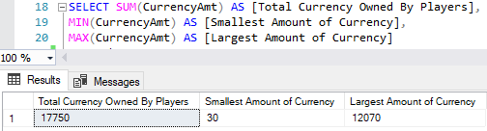
Summary Query #2
Gets total amount of currency owned by different players, the smallest amount of currency a player owns, and the largest amount of currency a player owns.

Slide 12
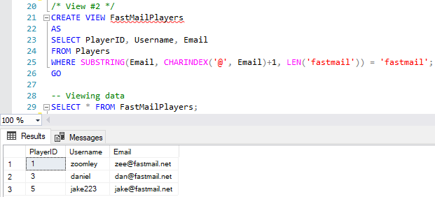
View #1
Contains the usernames and IDs of every player that uses the fictional “fastmail” email service.

Slide 13
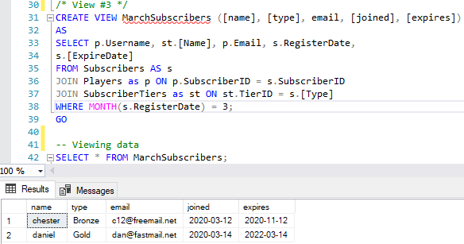
View #2
Contains information about players who subscribed in March.

Slide 14
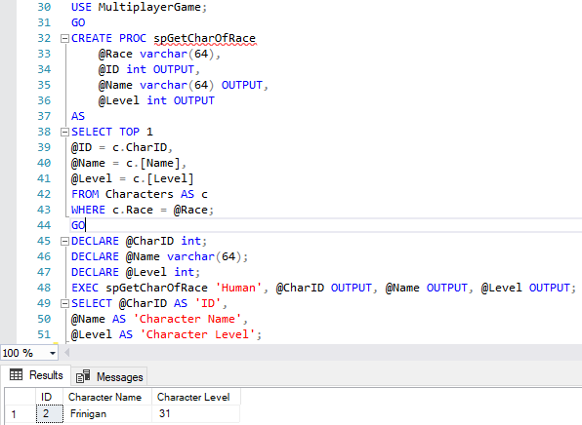
Stored Procedure #1
Gets a character’s ID, name, and level when given a name of a fictional race.

Slide 15
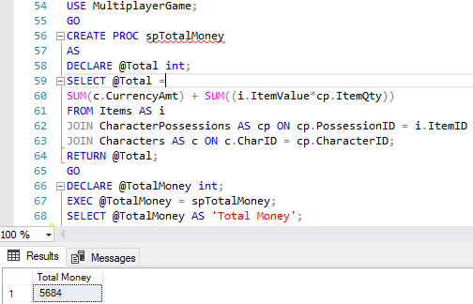
Stored Procedure #2
Gets the total amount of currency that exists based on the value of items owned by players plus the currency each player owns.

Slide 16
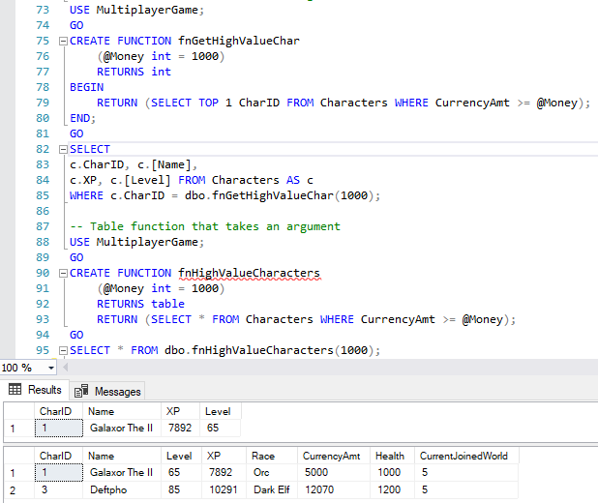
User Defined Functions #1 and #2
Both functions are used to find a character or characters that have a certain amount of money. The first function returns a single character and the other can return more than one.

Slide 17
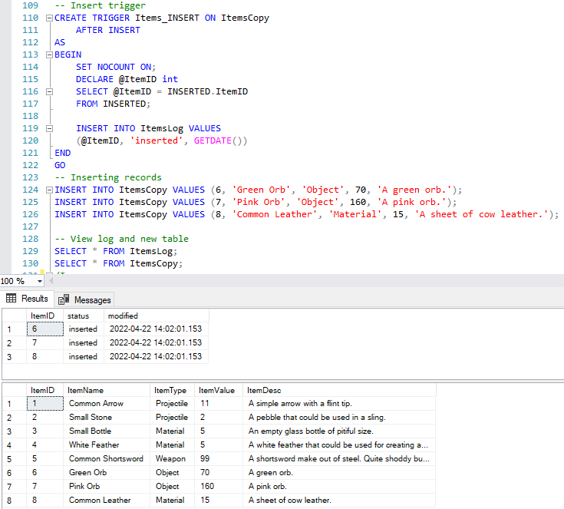
Trigger #1
Adds a row into a log table that shows that a row was inserted into the Items table and the date the action was performed.

Slide 18
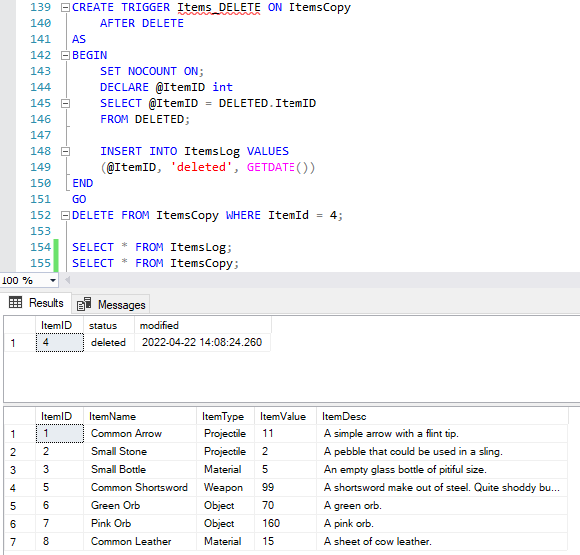
Trigger #2
Adds a row into a log table that shows a row was deleted from the Items table and the date the deletion was performed.

Slide 19
What I excelled at
Creating the stored procedures
Creating the aggregate queries
Setting up the tables and the way they relate to each other (foreign keys)

Slide 20
What I struggled with
Creating triggers that would function without being to complex
Creating user defined functions to work with the little data I had put into the tables

Slide 21
What I learned about
How to use stored procedures
How to create user defined functions with arguments
How to use aggregate queries within other constructs
How to create temporary tables

Slide 22
What I would do in the future
In a second version of the database, I would restructure the tables’ columns and if needed create additional tables to fit certain needs of this hypothetical game
The second version would also have functions and stored procedures that would be more useful for gathering data

